Slide 1

HEALTHCARE CHATBOT
Faculty of Science of Monastir
Mini project of ‘Projet Fédérateur Machine Learning ‘
Directed by :
Bacem BOUKHATEM
Amir AMEMI
Guided by :
Ms.Hela Haj MOHAMED
Date : 16 / 01 / 2024
Notes:
Good morning, ladies and gentelmen . I appreciate your valuable time today.
As you know, my name is Amir Amemi , and I am accompanied by Bacem boukhatem. We are both actively engaged in the data science field.
We are present today our project Helthcare chatbot guided by Ms.Hela haj Mohamed So, our Table of contents was devided into 4 main parts , was ..

Slide 2
TABLE OF CONTENTS
01.
Data Collection
02.
Machine Learning Models
03.
Voice Integration
04.
Conclusion
Overview of Datasets
Dataset Details
Decision Tree Classifier
Support Vector Machine (SVM)
Choice of Models
Integration of Voice Reading Feature
Enhancing User Experience
Summary of Achievements
Significance of the Project
Future Directions
Notes:
So the first part was Data collection , secoond machine learning models and voice integration and we will close with Conlusion

Slide 3
Motivation
Ask CHATBOT and get instantly answers.
Where Virtual Assistance Meets Medical Insights!
Get ready to embark on a health discovery like never before!
3
Notes:
our Healthcare ChatBot! It's like a virtual assistant for your health.
Just share your symptoms, and the ChatBot will suggest possible health conditions using smart tech.
Think of it as a quick chat with a knowledgeable friend who helps you figure out what might be going on.
We use cool computer science tricks to make these suggestions, all kept simple and straightforward in Python!

Slide 4
01.
Data Collection
Overview of Datasets
Dataset Details

Slide 5
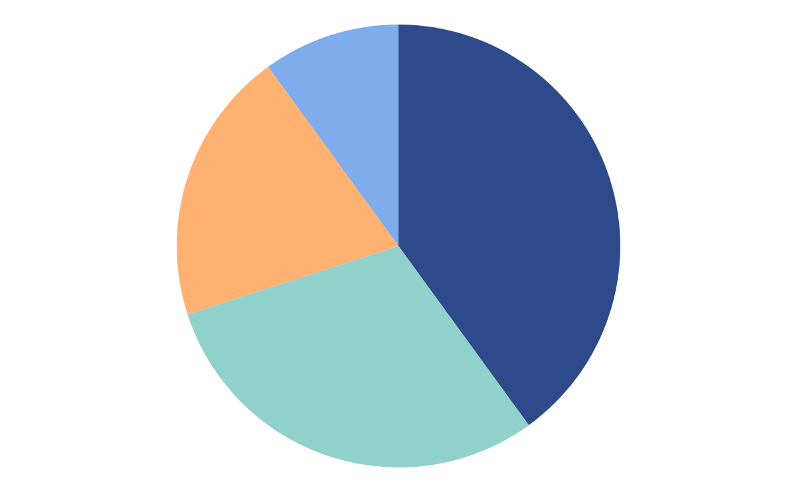

OUR Data
Dataset
Symptom Precaution
Main Data set.
4921 Rows
133 Columns
Precaution measures.
41 Rows.
5 Columns.
Symptom Severity
Symptom Description
Severity Rate.
133 Rows.
2 Columns
Disease description.
41 Rows
2 Columns
The selection from Kaggle ensures a high-quality foundation for our machine learning models
5
Notes:
Data.csv : This cleaned dataset, consisting of 4921 rows and 133 columns, is the main dataset utilized for building machine learning models. It plays a crucial role in training and testing the predictive models.
Symptom_Severity.csv: Dedicated to symptoms, this dataset assigns a severity rating (ranging from 1 to 7) to each symptom. Comprising 132 rows and 2 columns, it aids in assessing the gravity of reported symptoms.
Symptom_Precaution.csv: Focused on diseases, this dataset lists four precautionary measures for each disease. With 41 rows and 5 columns, it equips the chatbot to offer relevant advice to users based on reported symptom
Symptom_Description.csv: This dataset holds information about diseases, providing a detailed description for each disease. With 41 rows and 2 columns, it enriches the chatbot's understanding of various medical conditions.
We chose this dataset because it's clean and has lots of useful and rich information. Picking it from Kaggle guarantees a solid base for our machine learning models.

Slide 6
02.
Machine Learning Models
Decision Tree Classifier
Support Vector Machine (SVM)
Choice of Models

Slide 7
Decision Tree Classifier
Support Vector Machine
Choice of Models
7
Notes:
We selected two powerful machine learning models: the Decision Tree Classifier and Support Vector Machine (SVM). These models are renowned for their effectiveness in classification tasks, making them ideal for predicting medical conditions based on user-reported symptoms.

Slide 8
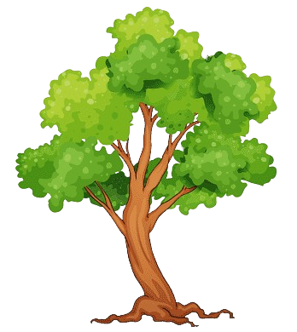
Decision Tree Classifier
How does the Decision Tree Classifier achieve such scores and cross-validation?
A perfect 1.0 score on the training set
Consistent cross-validation scores of [0.972, 0.978, 0.978].
An impressive mean accuracy of 0.975
8
Notes:
Training the Model :The Decision Tree model underwent rigorous training using the available dataset, enabling it to learn intricate patterns and relationships between symptoms and prognoses. This training phase is crucial for the model's accuracy in providing reliable predictions.

Slide 9

Support Vector Machines
How does the Decision Tree Classifier achieve such scores and cross-validation?
A perfect 1.0 score on the training set
Consistent cross-validation scores of [1.0, 1.0, 1.0].
An impressive mean accuracy of 1.0
9
Notes:
Training the Model :Similar to the Decision Tree, the SVM underwent thorough training to grasp the intricate relationships within the dataset. The synergy between these models enhances the overall predictive accuracy of our Healthcare ChatBot

Slide 10
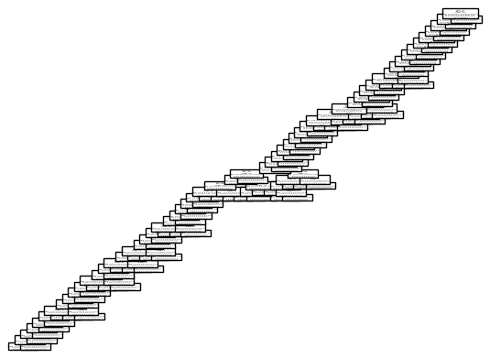
Decision Tree vs SVM
Why decision tree classifier better with this Dataset ?
interpretability
simplicity
Speed
Figure : Relation Between features on Decision Tree Classifier
10
Notes:
We chose Decision Tree over SVM for our healthcare chatbot due to its interpretability, simplicity, and speed, making it well-suited for real-time predictions. Decision trees excel in explaining decision logic and handling non-linear relationships, crucial for transparency and capturing complex symptom interactions in the medical context.

Slide 11
03.
Voice Integration
Integration of Voice Reading Feature
Enhancing User Experience

Slide 12

Voice Integration
Objective : Provide an enhanced and accessible user experience.
Language : English.
Role : Asking and response .
12
Notes:
The integration of a Voice Reading feature aims to provide an enhanced and accessible user experience within the Healthcare ChatBot.
Users can listen to responses, disease descriptions,, creating a more natural and interactive conversation.
The chatbot utilizes the pyttsx3 library in Python for text-to-speech conversion.
By integrating this feature, the chatbot aims to keep users engaged, informed, and satisfied.

Slide 13
04.
Conclusion
Summary of Achievements
Significance of the Project
Future Directions

Slide 14
Conclusion
✅ Successful Implementation
✅ Continuous Model Training
✅ Integration with Healthcare Systems
14
Notes:
Successful Implementation: The Healthcare ChatBot project has been successfully implemented, offering users a reliable platform to assess potential medical conditions based on symptoms.
Continuous Model Training: Consider implementing a system for continuous model training to enhance prediction accuracy with an expanding dataset and evolving medical knowledge.
Integration with Healthcare Systems: Explore opportunities for integration with existing healthcare systems to provide a seamless transition for users seeking professional medical assistance.

Slide 15







THANKS!
Do you have any questions?

